Slide 1
Doing Things in R That I Normally Do in Illustrator and Photoshop
Kati Perry
NACIS 2022
Notes:
Morning, y’all! My name is Kati Perry, and I’m a graphics reporter at the Washington Post. I wanted to demo some hacks and tricks to do in R what I normally would do in Photoshop and Illustrator

Slide 2
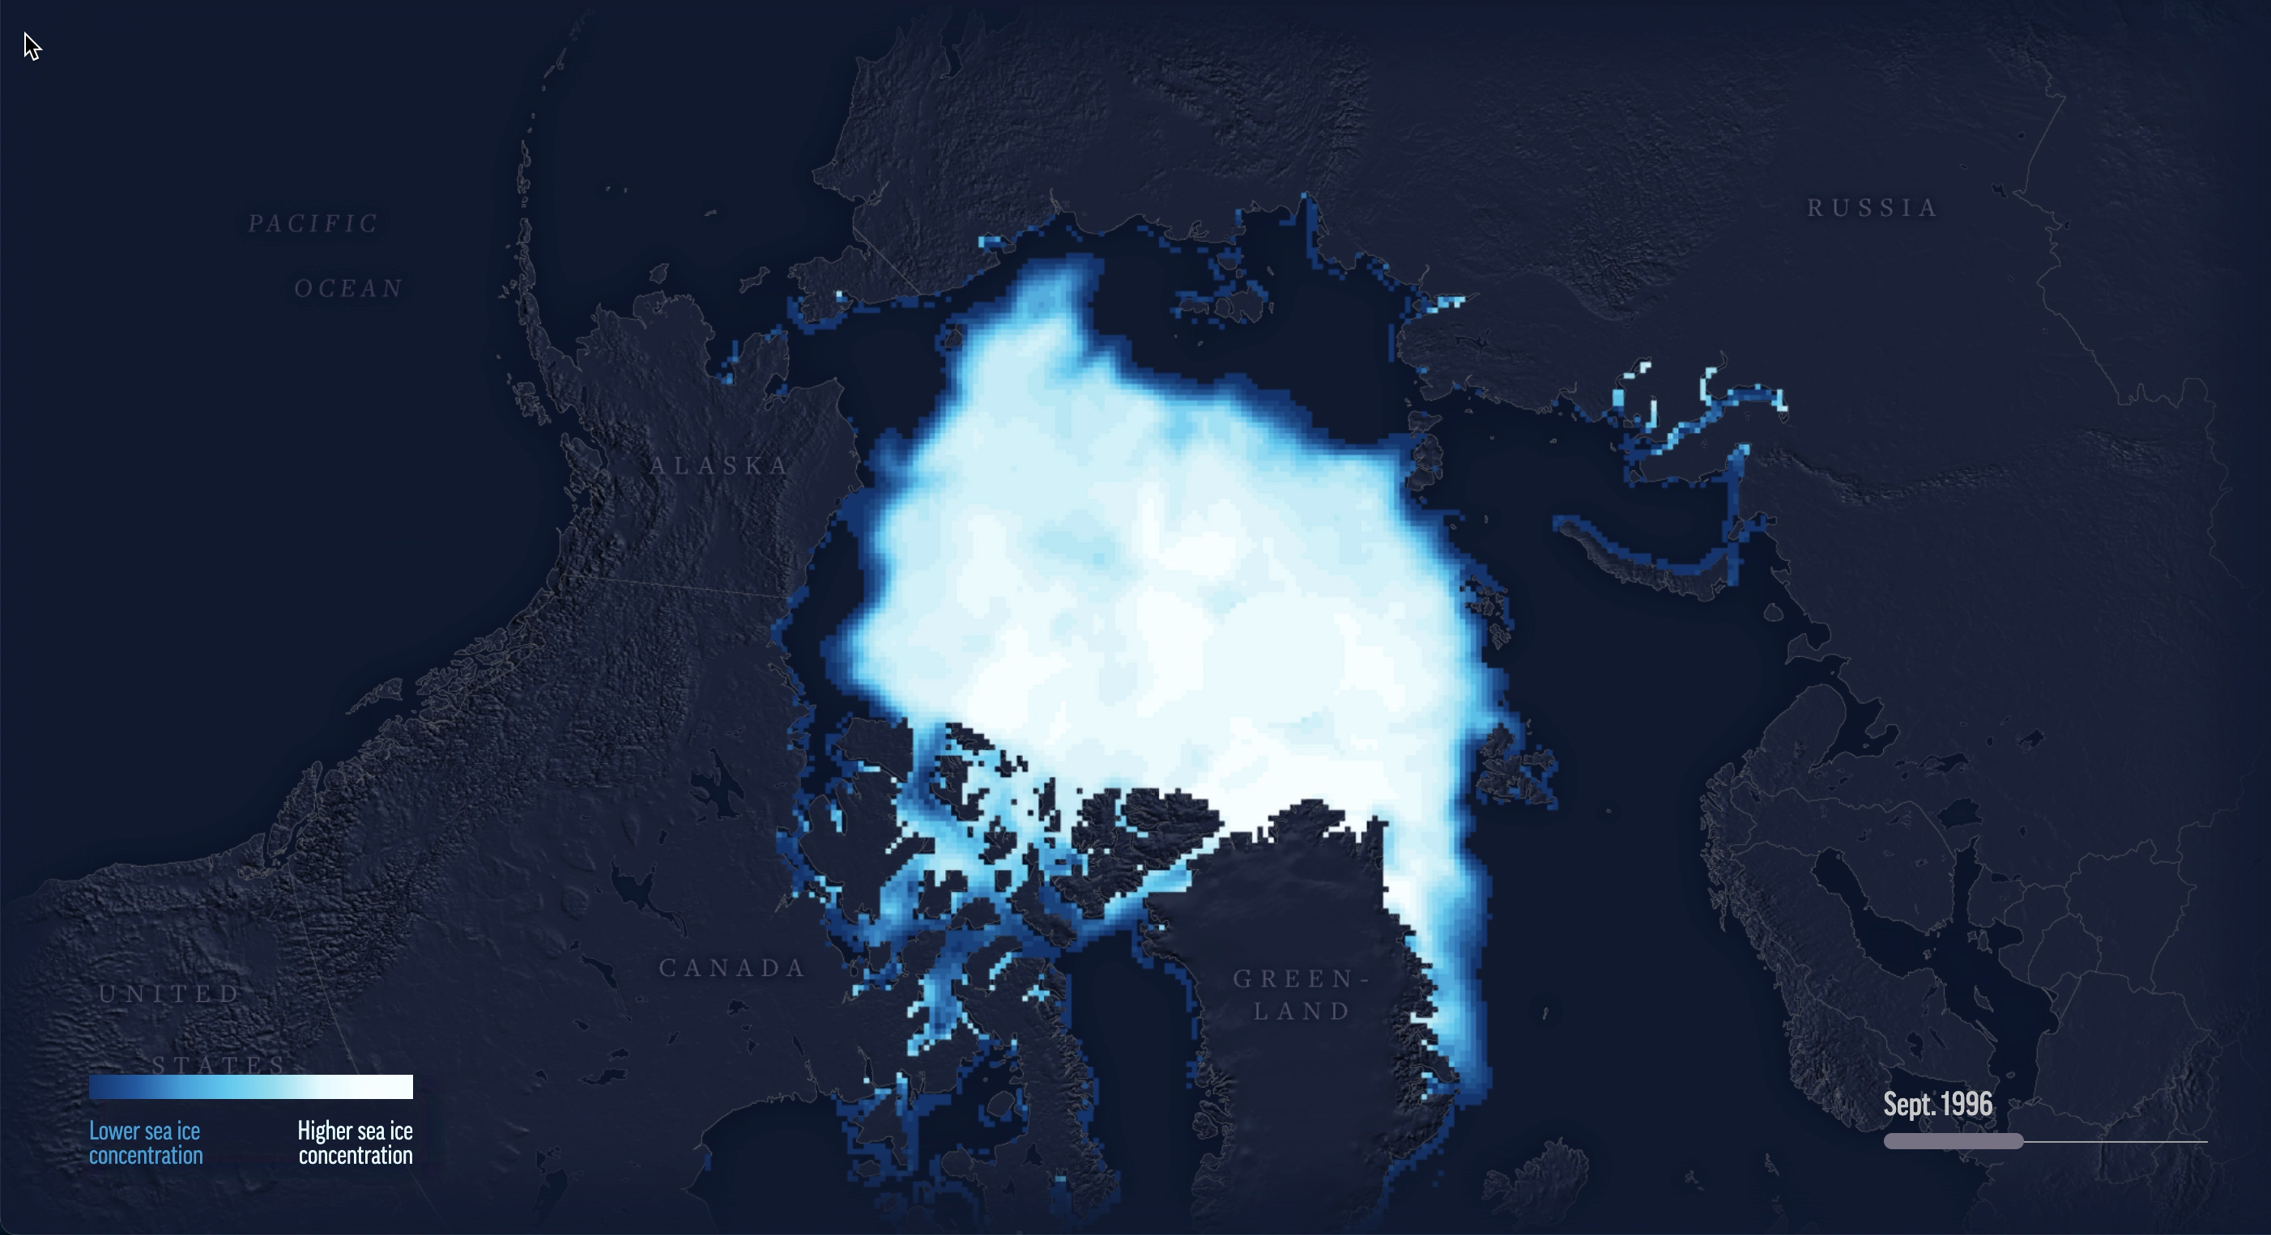
Notes:
So here’s the scenario: last year, I worked on a story at the Associated Press about disappearing sea ice and its impacts on polar bears, and I needed pngs of the sea ice for every year from 1978 to 2021. I also needed to be able to place them right on top of this basemap, AND I wanted a custom color scale. Normally if I need a png from a geotiff that’s georeferenced and with a custom color scale, I’d use qgis and photoshop and Illustrator but in this case because I needed almost four dozen layers, and I wanted a programmatic solution – because what if we want a slightly different shade of blue or the map extent changes?

Slide 3
Spoiler: colors and extent did change
Notes:
Spoiler: we DID want a different shade of blue and the map extent did change… ANYWAY

Slide 4
Is this the only way to do this?
100% no
Is this even the right way?
Not sure
🤷🏻
Does it work?
Usually
Notes:
So before we jump into the code, a couple of quick disclaimers: Is this the only way to do this? Definitely not. Is this even the right way? Not sure. Does it work? Usually. Just kidding….I mean we are going live code so who knows but I have tested it a lot so fingers crossed. Bottom line, many ways to make a map and this is just one hacky way

Slide 5
Create a custom color palette
Generate pngs with transparent backgrounds
Scale to the size of the basemap
Crop everything!
Notes:
So the things we’re going to do here are create the custom color palette…

Slide 6
Create a custom color palette
Generate pngs with transparent backgrounds
Scale to the size of the basemap
Crop everything!
Notes:
Generate pngs of the sea ice data with transparent backgrounds

Slide 7
Create a custom color palette
Generate pngs with transparent backgrounds
Scale to the size of the basemap
Crop everything!
Notes:
Scale everything to the size of the basemap

Slide 8
Create a custom color palette
Generate pngs with transparent backgrounds
Scale to the size of the basemap
Crop everything!
Notes:
And finally crop everything to the extent that we want!

Slide 10

< Find the code here
Thanks so much!
@kt_prry

